Slide 1
Presentation to Department of Higher Education and Training
Exemption Processes and Procedures
3 December 2015
Annie Viljoen
Clayton Lesufi

Slide 2
UNIVERSITIES SOUTH AFRICA BACKGROUND
Formed on 9 May 2005
Name changed from HESA to Universities South Africa on 22 July 2015
Establishment driven by restructuring of HE sector – new institutional types (mergers & incorporations)
Successor of SAUVCA (CUP) and CTP
Represents 26 public universities
Section 21 company, and voluntary

Slide 3
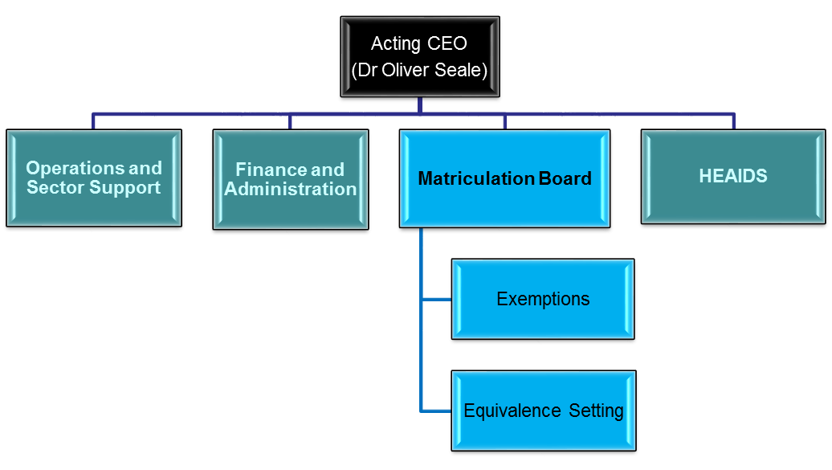
Where do we fit into Universities South Africa?

Slide 4
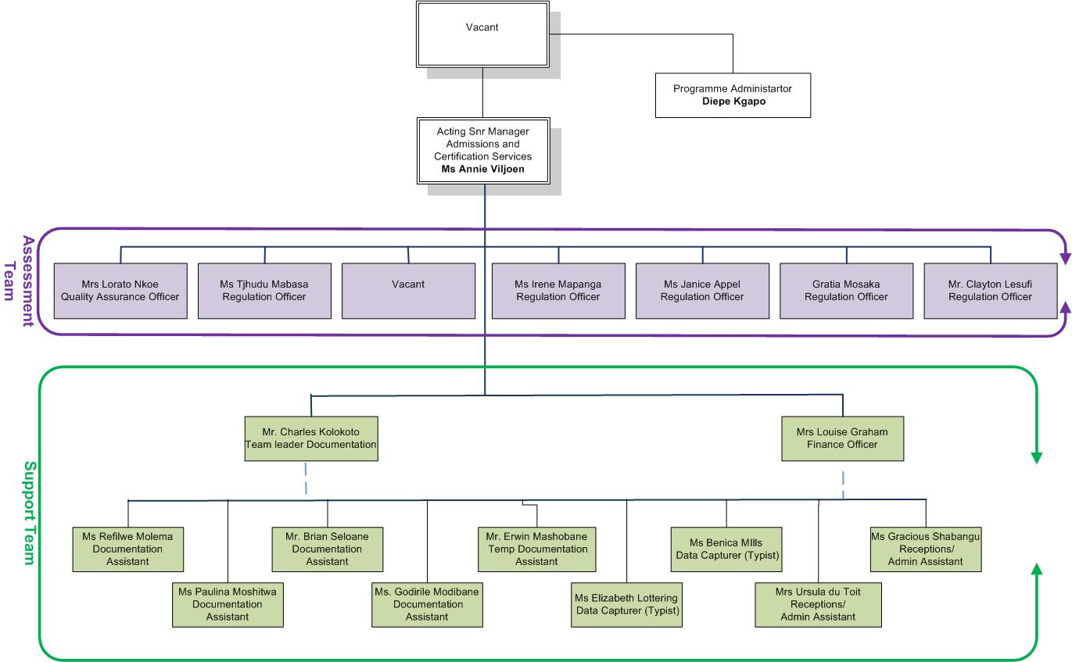
Matriculation board organogram

Slide 5
MATRICULATION BOARD HISTORY
The Matriculation Board has a long history that dates back to statutory responsibilities vested in the then Joint Matriculation Board (JMB). The JMB operated from 1918 to 1992 when it was dissolved and its records were transferred to the Matriculation Board, a statutory advisory structure of SAUVCA.
The Higher Education Act 101 of 1997 provides for the functions of the Matriculation Board to determine minimum general university admission requirements better known as matriculation endorsement requirements which are determined and are published in the Government Gazette.
This act also allows the Universities to determine their own additional admissions requirements.

Slide 6
STAFF AND FUNCTIONS
The Matriculation Board has a staff complement of 19 members who are responsible for administering the government-approved endorsement and exemption regulations and resolutions. The Matriculation Board committee continues to fulfil its statutory role and function in regulating admissions to degree studies, which entails a range of services:
  Certifying applications for exemption from the matriculation endorsement requirements;
  Benchmarking international and regional qualifications such as those from South African Development Community (SADC) and maintaining international profiles on 176 countries; and
  Providing critical advisory services to schools, parents and higher education institutions regarding minimum admission requirements.

Slide 7
MATRICULATION BOARD & SAQA CEEQ – Different Services for the same HE sector
One of the questions that often arise from the prospective foreign student community is the interface between SAQA and Universities South Africa functions within the similar post school environment.
The Matriculation Board Unit of Universities South Africa is responsible for administering the Government Gazetted regulations for admission in to bachelor’s degree studies. In other words, it mainly evaluates applications to establish if applicants meet the exemption requirements and issue exemptions accordingly.
SAQA CEEQ Unit evaluates foreign academic qualifications to establish their level when compared to SA qualifications of similar nature.
In a nutshell, SAQA (CEEQ) function is in the main about “equivalence” whereas the MB function is to determine whether applications are “meeting the minimum degree admission requirements”
The Universities South Africa exemption certificate is compulsory whilst the SAQA certificate is optional

Slide 8
EXEMPTION APPLICATION PROCESS

Slide 9
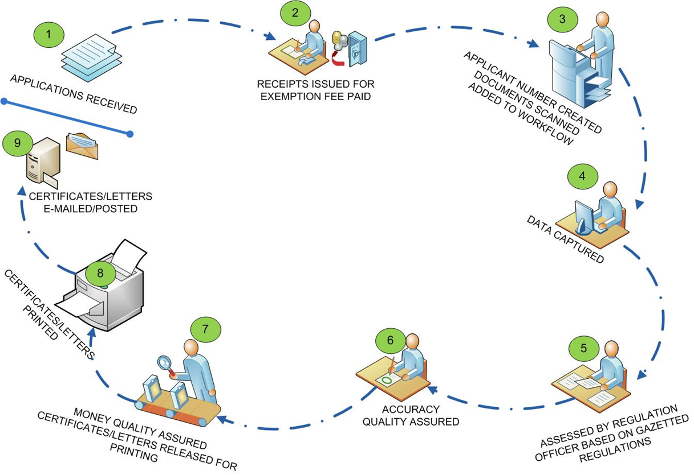
EXEMPTION PROCESS

Slide 10
APPLICATION PROCEDURE
THERE ARE A FEW DIFFERENT WAYS TO APPLY FOR AN EXEMPTION:
Submitted per list by the Institutions:
  The institution submits the applications and supporting documents together with payment. We endeavour to finalise these applications within 6-8 weeks from receipt. Printed certificates are e-mailed to the institution and posted/e-mailed to the student.
Submitted by the institution via MBIT online (from October 2015)
  The institution submits the applications and supporting documents together with payment via the online portal. We endeavour to finalise these applications within 6-8 weeks from receipt. Printed certificates are e-mailed to the institution and posted/e-mailed to the student
Individual Fax, e-mail or online application:
  This process takes 3-5 working days and a provisional letter is issued indicating what type of exemption will be issued upon receipt of correctly certified documents and payment.
Individual Post or courier application:
  Correctly certified documents are posted or couriered. A certificate/ letter is issued in 6-8 weeks.
Individual apply in person at our offices:
  Prospective students have the option to apply in person at our offices and make payment. They are issued with a letter indicating the level of exemption issued. Certificates are printed later and forwarded to the applicant

Slide 11
SUPPORTING DOCUMENTS REQUIRED
M30E application form
Copy of ID/Passport/Birth Certificate
School leaving certificates *
Academic records/transcripts of post school qualifications (if applicable)
  * if in foreign language the documents need to be translated and both the original language and sworn translated copies have to be submitted
  Statement of results is only suitable for a provisional letter as not all can be verified.

Slide 12
CERTIFICATION
All copies of documents need to be certified by:
  Registrar (or his delegated official) of the University
  Notary Public
  SA Embassy/High Commission in a foreign Country.

Slide 13
EXEMPTION FEES
The exemption fees are adjusted annually and are determined by the Joint Matriculation Board and Admissions Committee and approved by the Universities South Africa Board.
Fee structure:
  The application fee payable for certificates of complete or conditional exemption is standardised at R450 for 2016.
  The fee payable for amendment and duplicate certificates of exemption is R225.00 per application.
  From January 2016 all fees are payable up front.
Period of validity of certificates of conditional exemption:
  The period of validity of certificates of conditional exemption is five years, but the period will be two years beyond the full-time duration for degree programmes that exceeds the full-time duration of the final first degree

Slide 14
MINIMUM ADMISSION REQUIRMENTS

Slide 15
Types of exemptions lodged
Conditional Exemption Certificates
  Complete exemption certificates
N5 & Senior Certificate languages (par 19)
SYSTEM & Senior Certificate subjects (par 11)
ASECA & Senior Certificate subjects (par12)
Academic & Professional qualifications (par 17)
Post-school qualifications (par 18)
Senior certificate subjects & one language with 1st Language HG equivalence (par 19)
Senior certificate subjects & one recognized extra-curricular subject (par 20)
N5 & Senior Certificate languages (par 25)
Immigrant‘s (par 29)
Mature age (par 30)
Senate's discretionary (par 31)

Slide 16
Senior certificate and formal qualifications
The board issues complete exemption to holders of the senior certificate and national diplomas issued by the former Technikons and now universities of technology
The board issues complete exemption to holders of the senior certificate and two or three year diplomas issued by public universities.
Two senior certificate languages on higher grade plus four N5 subjects that include a senior certificate subject also qualify the holder for complete exemption.

Slide 17
Paragraph 17 Exemption
The board issues certificates of complete exemption to candidates who completed a qualification that is evaluated at Level 5 of the SAQA NQF with credit value of 120 or more obtained at an accredited institution (public or private).
These qualifications are normally offered at private institutions. Some are offered at public institutions e.g. Certificate in Dental Assistance offered by TUT.
Candidates aspiring for complete exemption through this route are strongly advised to check the registration status of the qualification with SAQA before proceeding with studies.

Slide 18
Mature Age exemption for +23 candidates
Individuals who are 23 years or older at the year of registration with the Pre-2008 Senior Certificate and foreign qualifications may qualify for a mature age exemption in terms of Paragraph 30 of the gazette or country specific regulations as gazetted and may be allowed to study towards a degree programme subject to faculty admission requirements.

Slide 19
Mature Age exemption for +45 candidates
Individuals who are 45 years or older are allowed by law to study towards a degree programme subject to faculty admission requirements.
In order for such applications to be processed a copy of the applicant’s ID need to be submitted together with the completed application form.

Slide 20
NATIONAL SENIOR CERTIFICATE (NSC) &
National Certificate Vocations (NCV)
The Matriculation Board of Universities SA does not administer the admission requirements for the NSC and NCV
Three further education pathways are automatically built on the qualification i.e. Bachelor’s degree; diploma or; higher certificate studies.
No mature age exemption pathway is available for NSC candidates.
Applicants without bachelor degree entry may be admitted into degree studies at the discretion of the Senate in terms of paragraph 31.

Slide 21
CONCLUSION
Policy as it stands today requires that prospective first degree students produce endorsed senior certificate or certificate of complete or conditional exemption from endorsement and exemption requirements
Foreign school leavers are also required to apply for conditional or complete exemption with the Matriculation Board of Universities SA before they can be considered for placement at various public SA universities.

